Slide 1

CH2200 Quantum Mechanics
Lecture 4: Rotational Motion and Angular Momentum

Slide 2

Last Lecture
We tackled the harmonic oscillator problem. This was similar to the particle in a box problem, but with a different potential energy.
Now we will move onto a different kind of motion entirely – rotational motion.
This requires that we understand things like angular momentum. Buckle up!

Slide 3
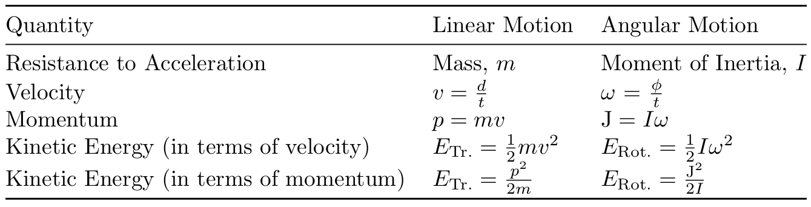
Classical Rotational Motion
We can treat rotational motion as analogous to translational motion.
Familiar quantities like mass, velocity, momentum, and kinetic energy all have rotational analogues!
We will explore these in more detail.

Slide 4
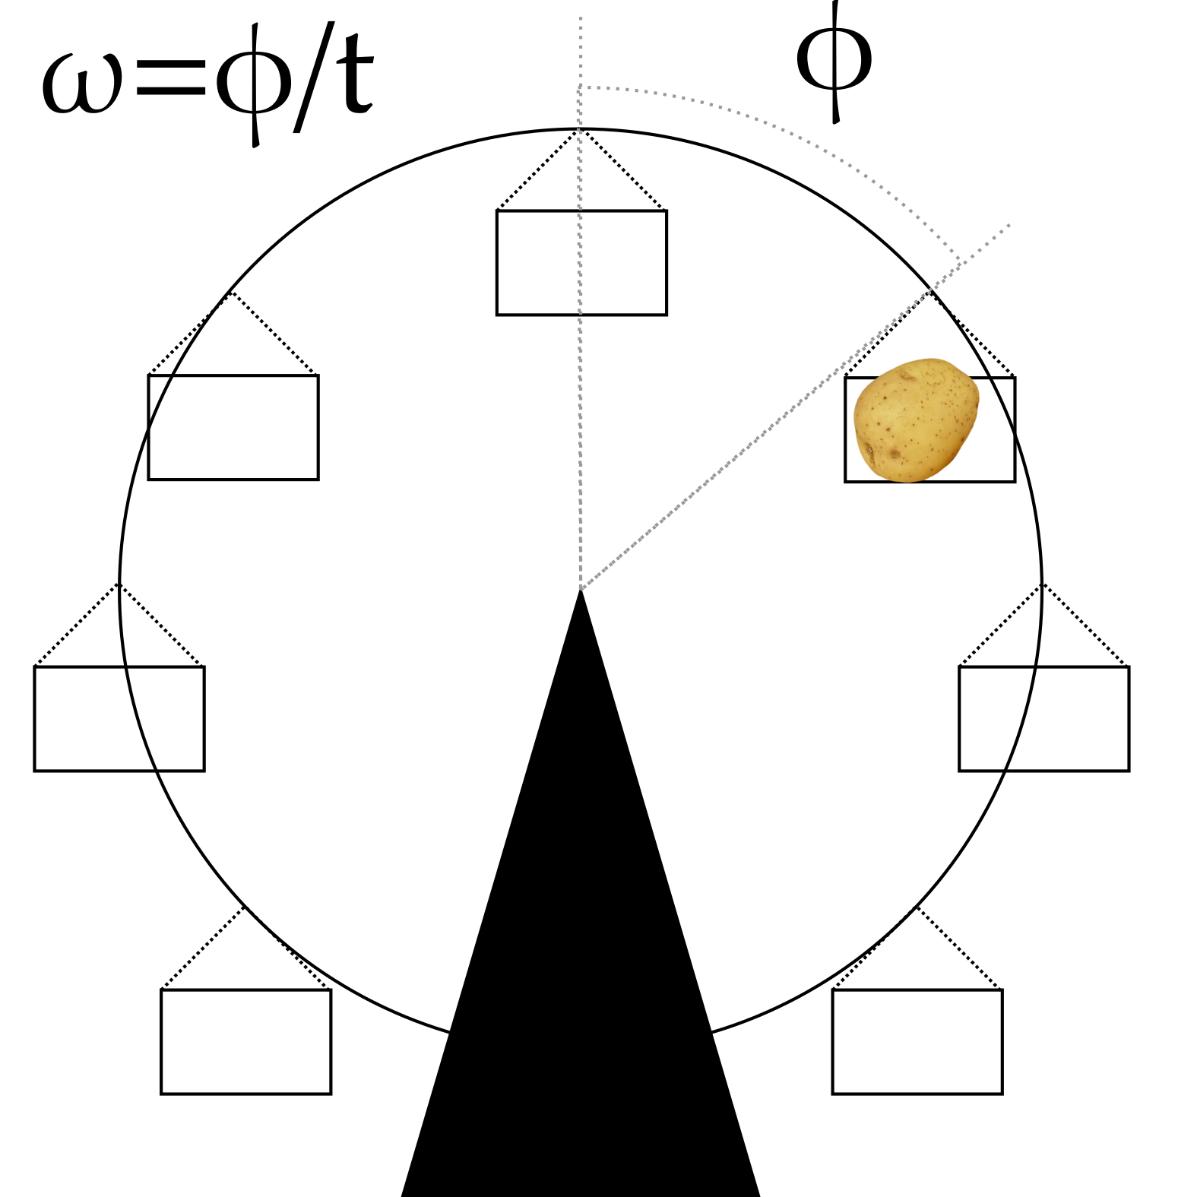
Angular Velocity
Linear velocity is simply defined as the distance travelled per unit time (normally seconds).
Angular velocity is defined as the angle swept out per unit time. It is given the symbol ω.
High angular velocity means that the potato spins faster!

Slide 5
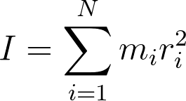
Moment of Inertia
Mass is how much something will resist linear acceleration.
Moment of Inertia is the equivalent for angular acceleration. It is sometimes called angular mass.
A large moment of inertia (symbol I) means it is difficult for an object to start rotating.

Slide 6
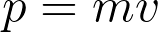
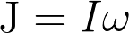
Angular Momentum
Linear momentum is the product of mass and velocity.
Angular momentum is the product of moment of inertia and angular velocity.
Total angular momentum is given the symbol J. We will use this when talking about classical rotation, or about the angular momentum of actual molecules.
Orbital angular momentum is given the symbol l. We will use this when solving our model systems.

Slide 7
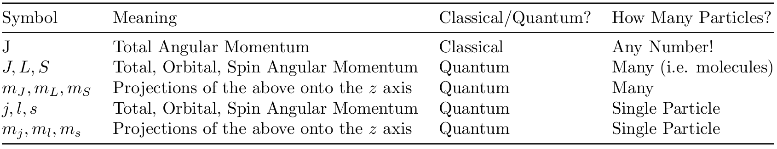
Nomenclature
The nomenclature surrounding angular momentum is a bit of a quagmire! See the table below:
J (non-italic) = classical angular momentum
Upper case = quantised, many particles
Lower case = quantised, single particle
J (italic) = total angular momentum (quantum)
L = orbital angular momentum
S = spin angular momentum

Slide 8
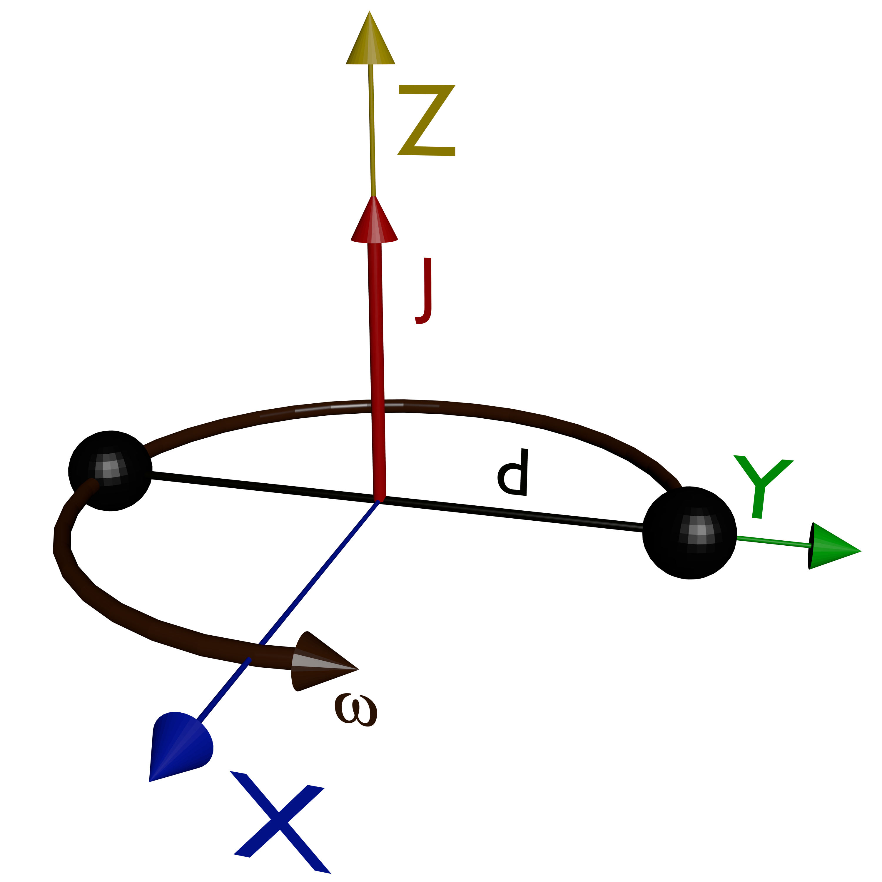
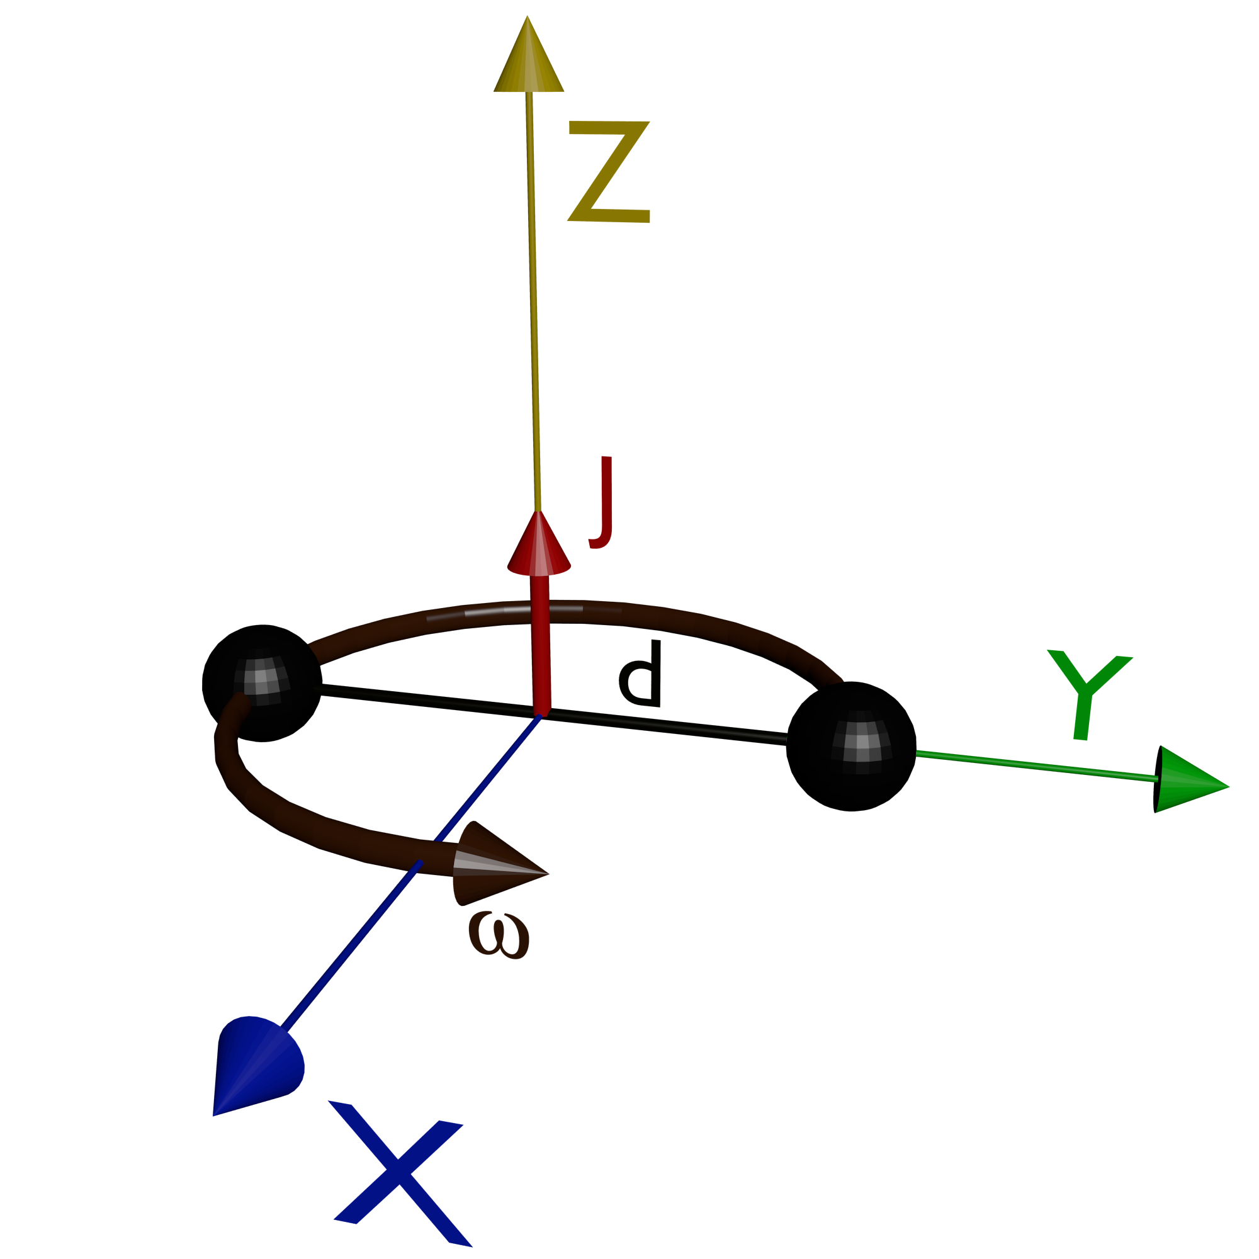
Angular Momentum
How do we physically represent angular momentum?
Larger bond distance = higher moment of inertia = larger angular momentum.

Slide 9
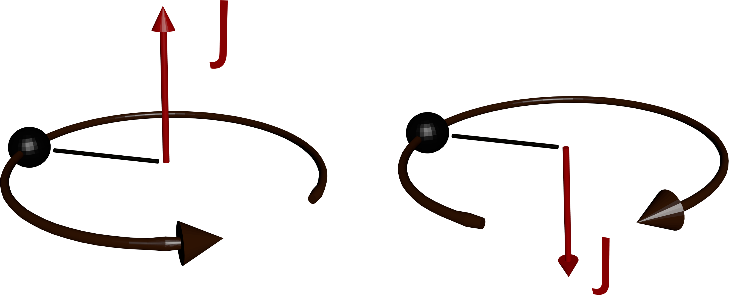
Angular Momentum
What about different directions of rotation?
Different directions of rotation give opposite signs for the angular momentum.
Can work out which is which using the right hand rule.

Slide 10
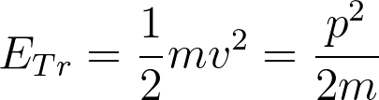
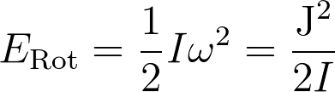
Rotational Kinetic Energy
Translational kinetic energy is given by:
By analogy, rotational kinetic energy is given by:
How do we treat rotational motion quantum mechanically?

Slide 11
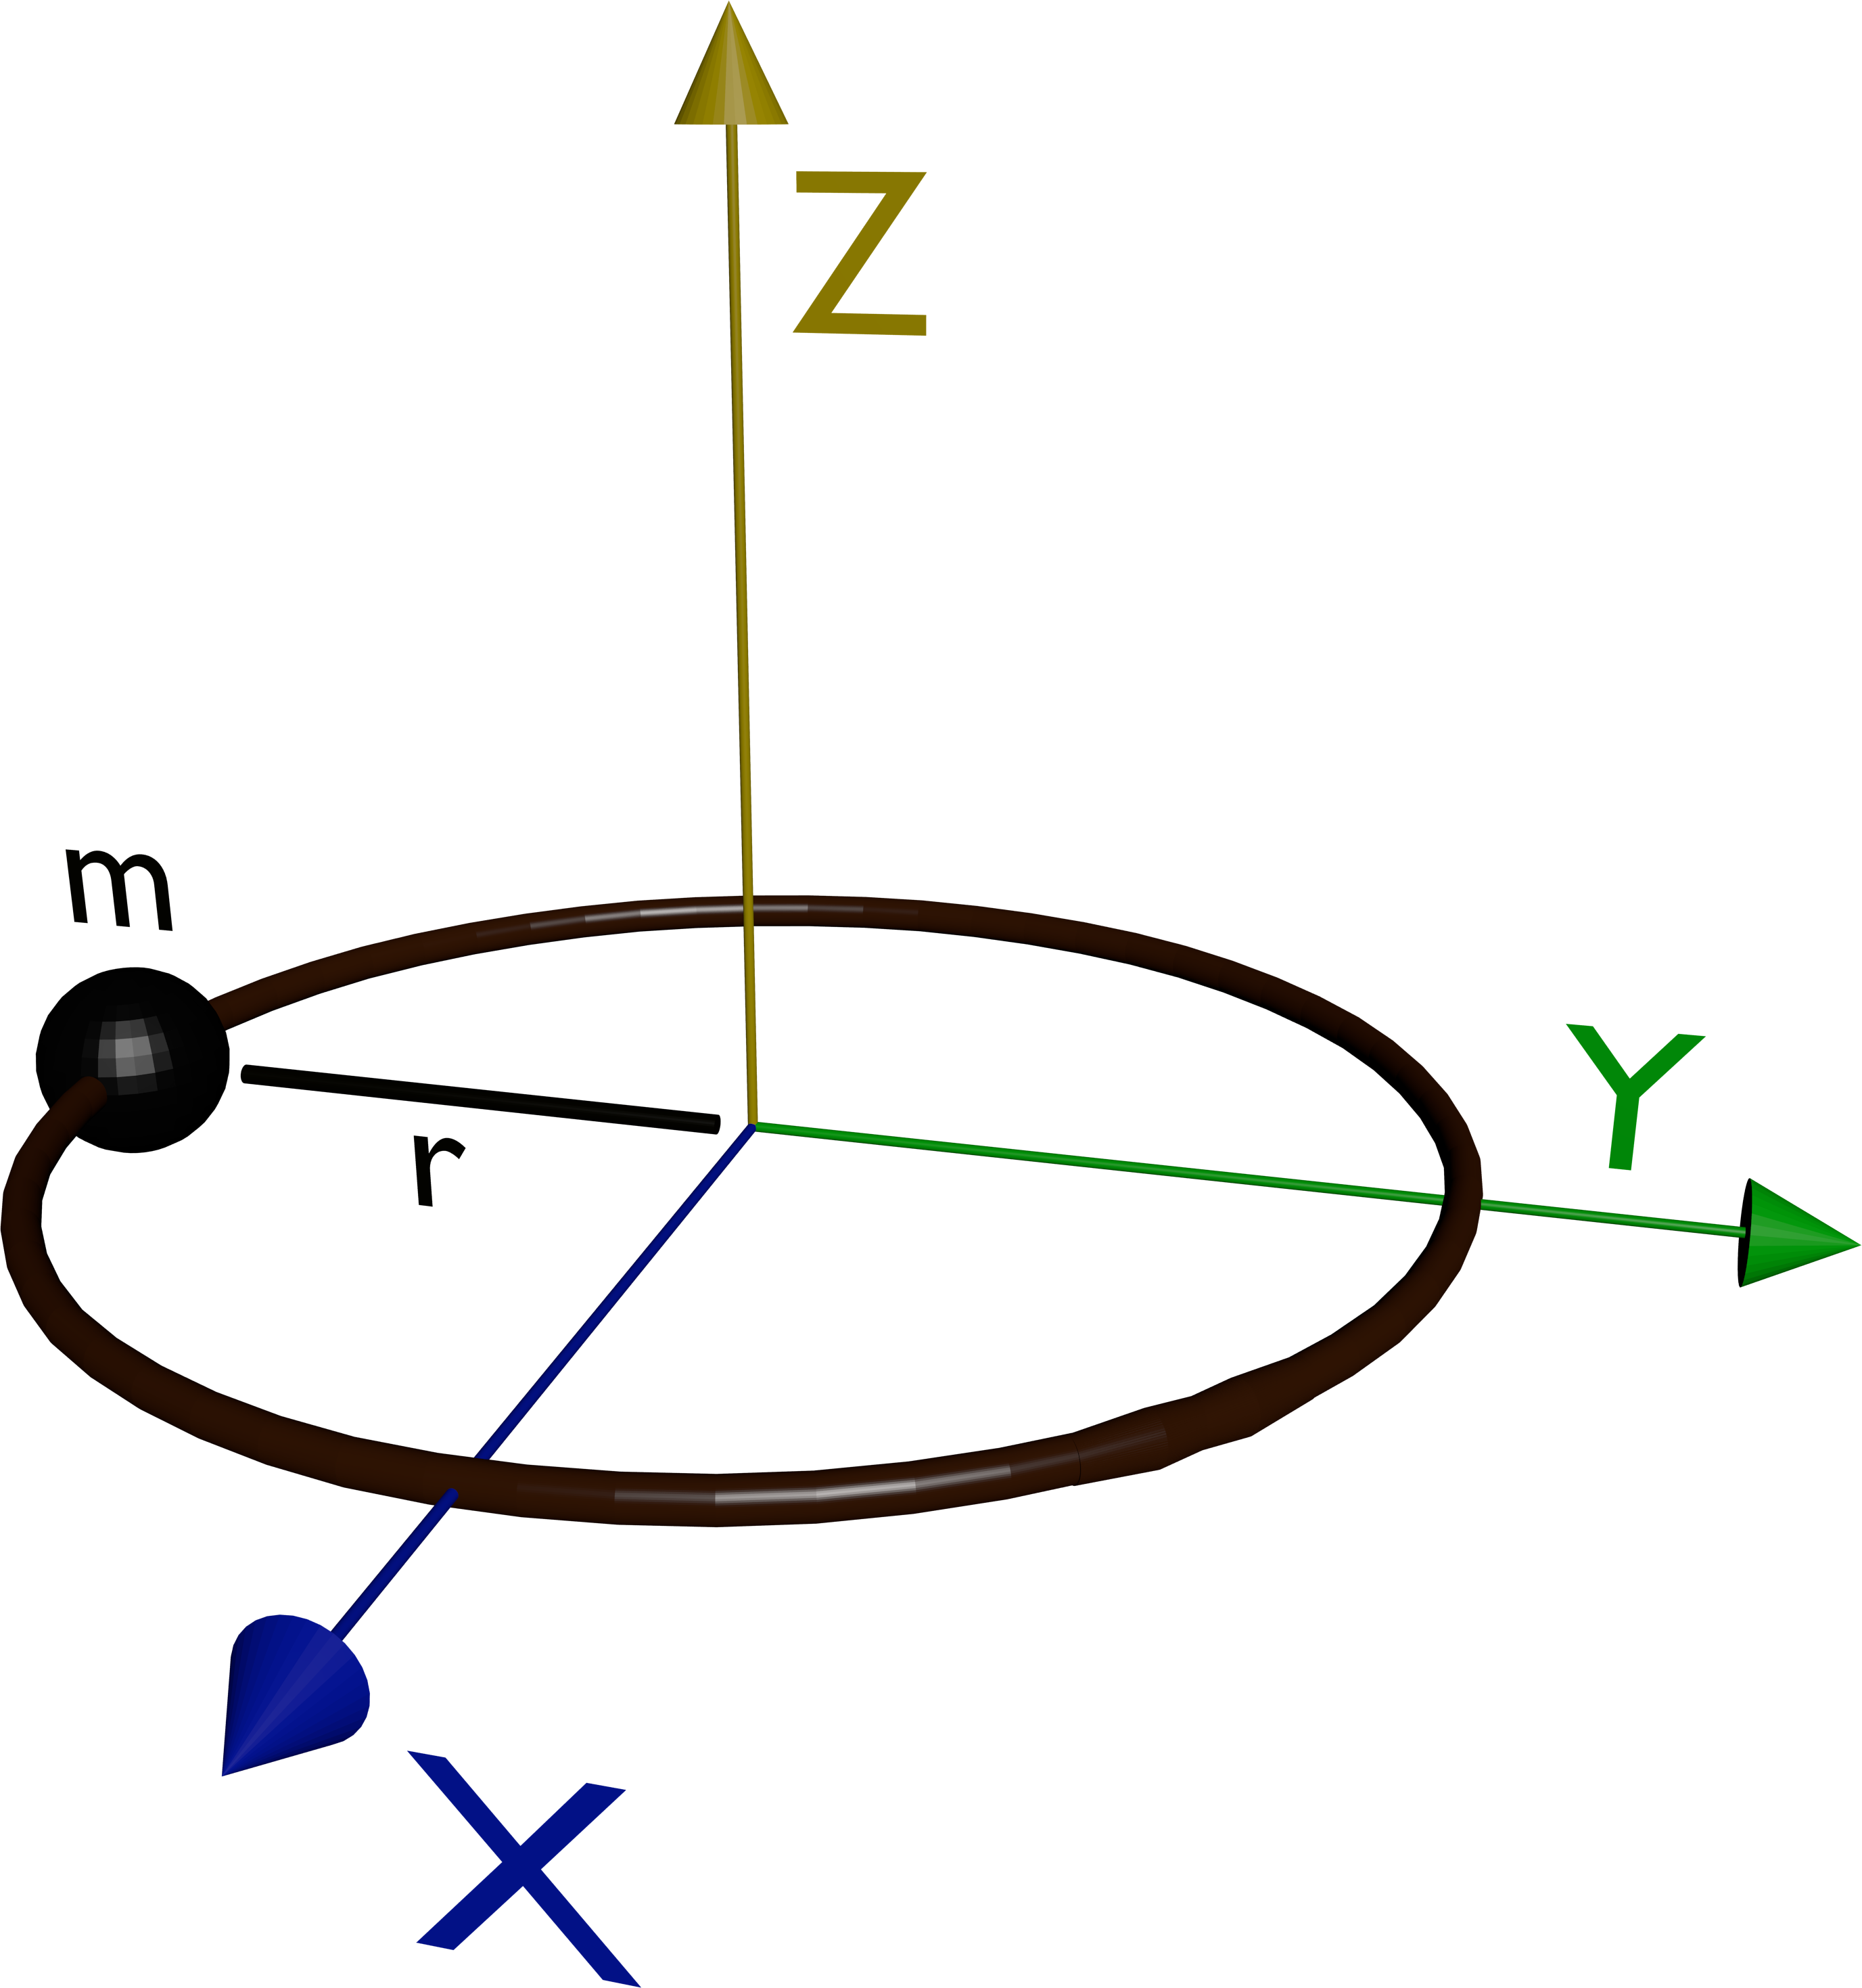
Particle on a Ring
Consider this model – a particle confined to a 2D ring.
The radius is fixed as the particle is confined to the ring.
The ring lies in the XY plane.
We don't have any potential energy to worry about, so what is the kinetic energy?

Slide 12
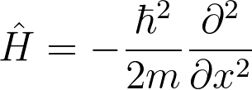
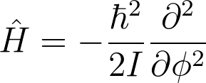
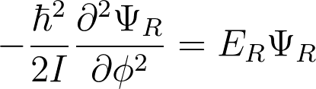
Particle on a Ring
If the particle was free to move linearly along x, we could define the Hamiltonian as:
How does this change for rotations? Swap m for I, and note that we rotate around an angle ϕ, not a distance x.
It's as easy as that! Our Schrödinger Equation therefore:

Slide 13
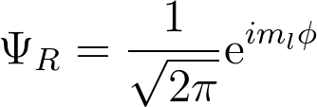
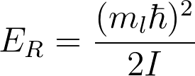
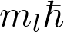
Particle on a Ring
Solving this equation is also a bit complex. The solutions are..
We have a new quantum number,
You can see that must correspond to angular momentum somehow.
No quantisation yet (can have any we like!) – need boundary conditions.

Slide 14
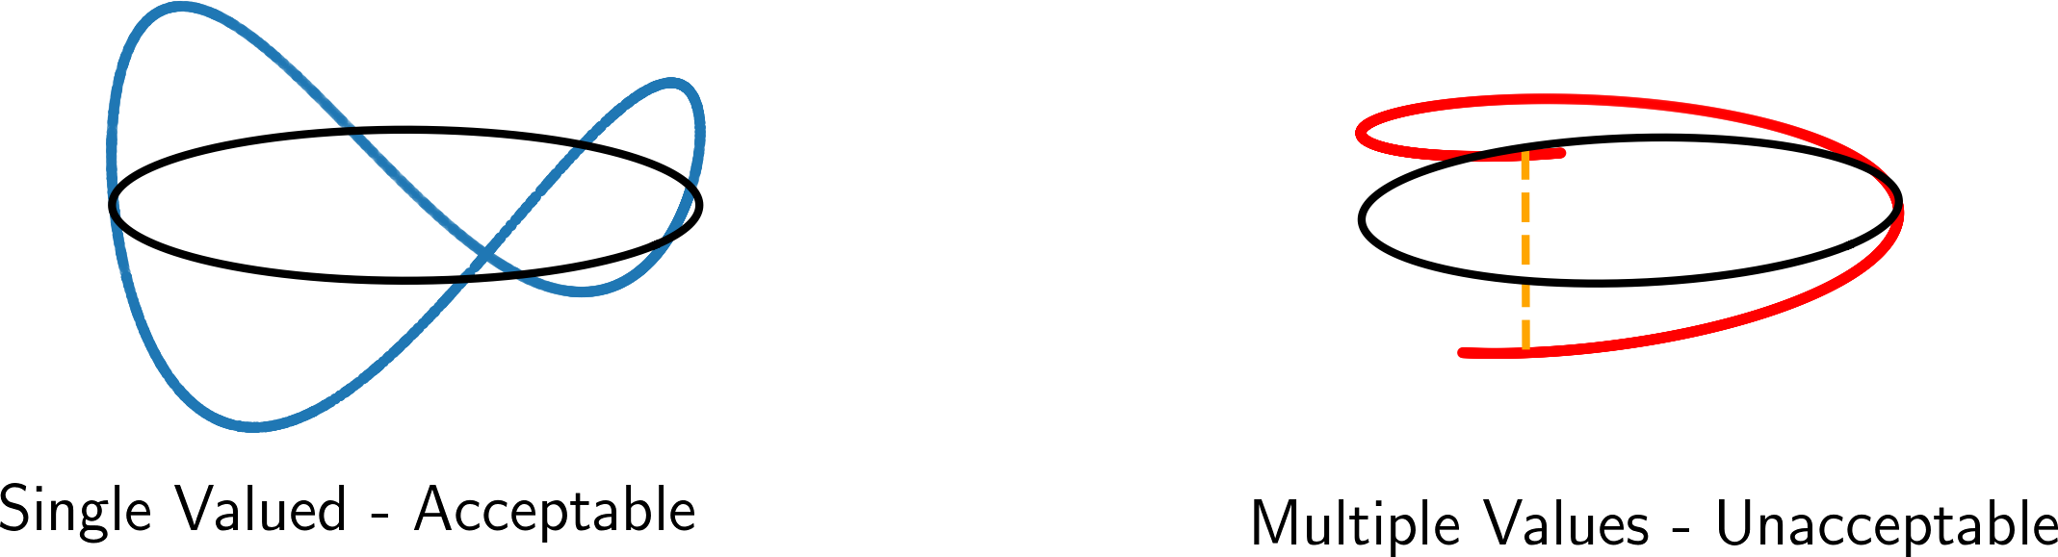
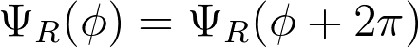
The Cyclic Boundary Condition
In previous cases, our boundary conditions arose because we had to make our wavefunction continuous.
For a particle on a ring, need to make sure our wavefunction is single-valued.
Solution – the cyclic boundary condition.

Slide 15
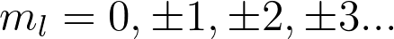
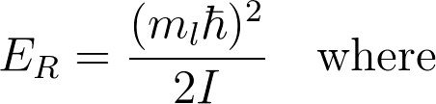
Quantised Rotational Energy
Applying the boundary condition tells us that:
Must be an integer, but can be positive or negative (different signs = different directions of rotation).
So are allowed energies are:
Quantised Rotation!

Slide 16
The Meaning of
How do we physically interpret ?
It must be related to angular momentum.
Remember our drawing earlier.
Clear that is the angular momentum along the rotation (z) axis!

Slide 17
Rotations – Summary so far
We have met the quantities angular velocity, moment of inertia, and angular momentum.
We can construct the Schrödinger Equation for 2D rotation - a particle on a ring.
We apply the cyclic boundary condition, and meet the first rotational quantum number -

Slide 18
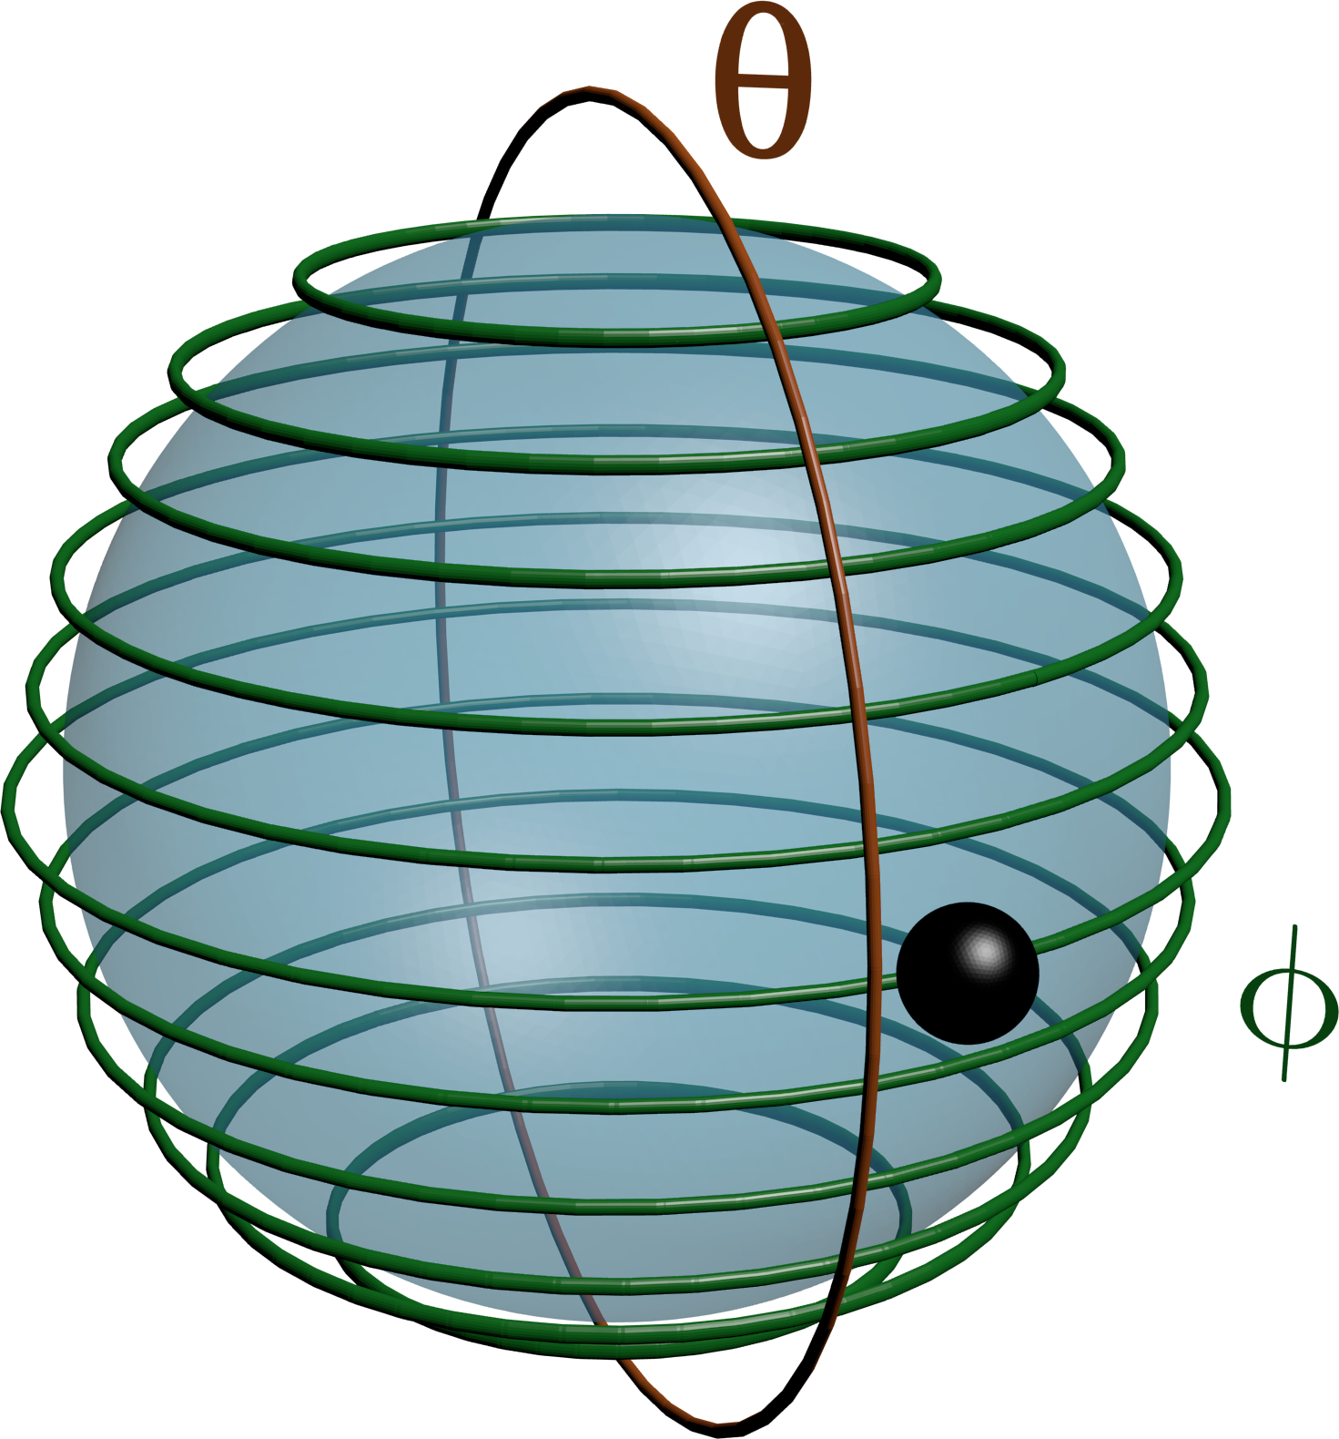
Next Lecture
We consider rotation in 3D – particle on a sphere – and angular momentum in more detail!

